Slide 1
Vibhaag Web App
A college analytics, session monitoring and
management tool
By,
Sudhanva N
PES1201702260
Karthik D
PES1201702449
Harsha K Y
PES1201801839
Guide:
Dr Veena S,
Chairperson,
Department of Computer
Applications

Slide 2
Abstract
The application consists of two components
The web application which helps monitor and manage the activities of the college
The mobile application for end users that acts as a companion and authentication tool
It records the time, date and location of the incident by a QR Code and sends the data securely to the web application

Slide 3
Literature Survey
Most companies keep track of their schedules, tasks manually (Books)
Social media and time management tools can only keep track of limited things
Traditional RFID/Card swiping systems and fingerprint readers are currently popular among most companies

Slide 4
Introduction
Custom time table for every batch and for every session
Faculties can confirm the class conduction using mobile apps with timings
Meaningful insights such as daily and weekly abstracts can be generated
Admins have the ability to change the time table and re-allocate faculties as per requirement

Slide 5
Tools and Technologies
Core
Deployment
Backend:
Node.js v10.x, Express.js v8.x
Frontend:
React.js v16.x, Redux v16.x
Database:
MongoDB v4.x
Testing:
Mocha, Postman
DevOps:
Github, Travis CI, AWS, Heroku
Other Tools:
Draw.io, Balsamiq

Slide 6
Functional Requirements
User authorization and authentication with role management
User should have restricted access, permission based creation of departments, faculty or any other entity
Customized schedules for sessions for different user or group along with notifications
Create departments, sessions, add faculty, add subjects

Slide 7
Non - Functional Requirements
Application is containerized for traffic distribution and scalability
Distributed version control and task management
Continuous integration and continuous delivery for seamless deployment
Works across devices or any screen via a browser

Slide 8
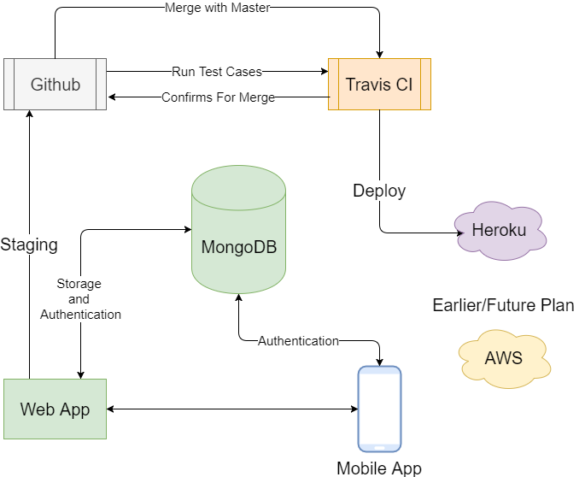
Data Flow

Slide 9
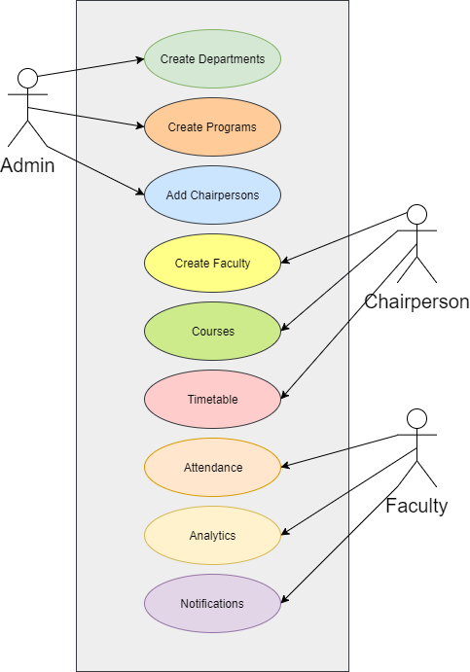
Use Cases

Slide 10
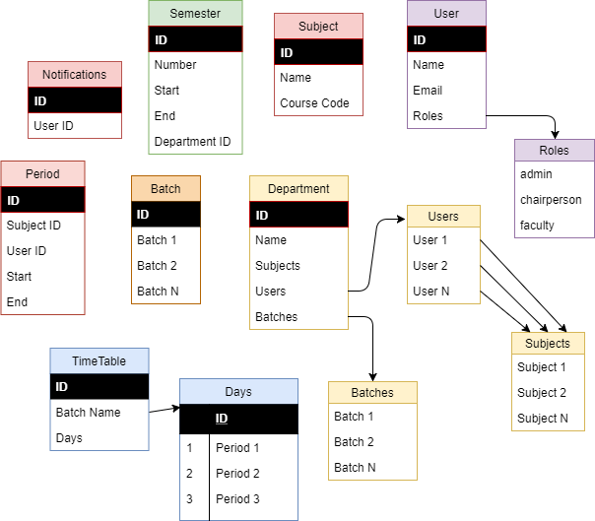
Database
Structure

Slide 11
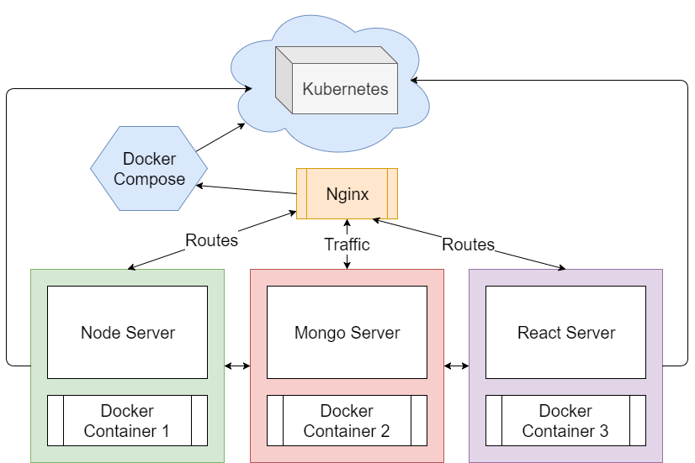
Planned
Architecture

Slide 12
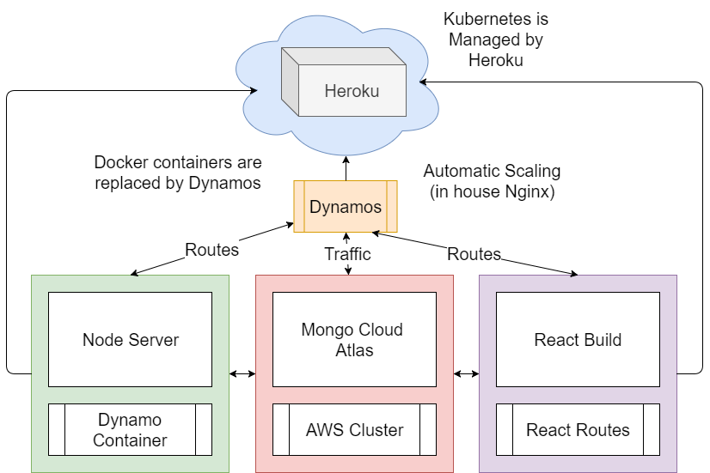
Implemented
Architecture

Slide 13
What Has Been Done So Far – Overall 50%
Routes setup for React, Redux and Node: 20%
Authentication using JSON Web Token: 80%
Backend with Frontend Setup for Development: 50%
Continuous Integration – Mocha, Coffee, Travis CI: 10%
Continuous Delivery – Github, Travis CI, Heroku: 100%

Slide 14
Demo

Slide 15
What Needs To Be Done
Working with Mobile Apps
API endpoint restructuring for Mobile Apps
Test cases for continuous integration
Backend with Frontend Setup for Production
Background jobs and scheduling

